Slide 1
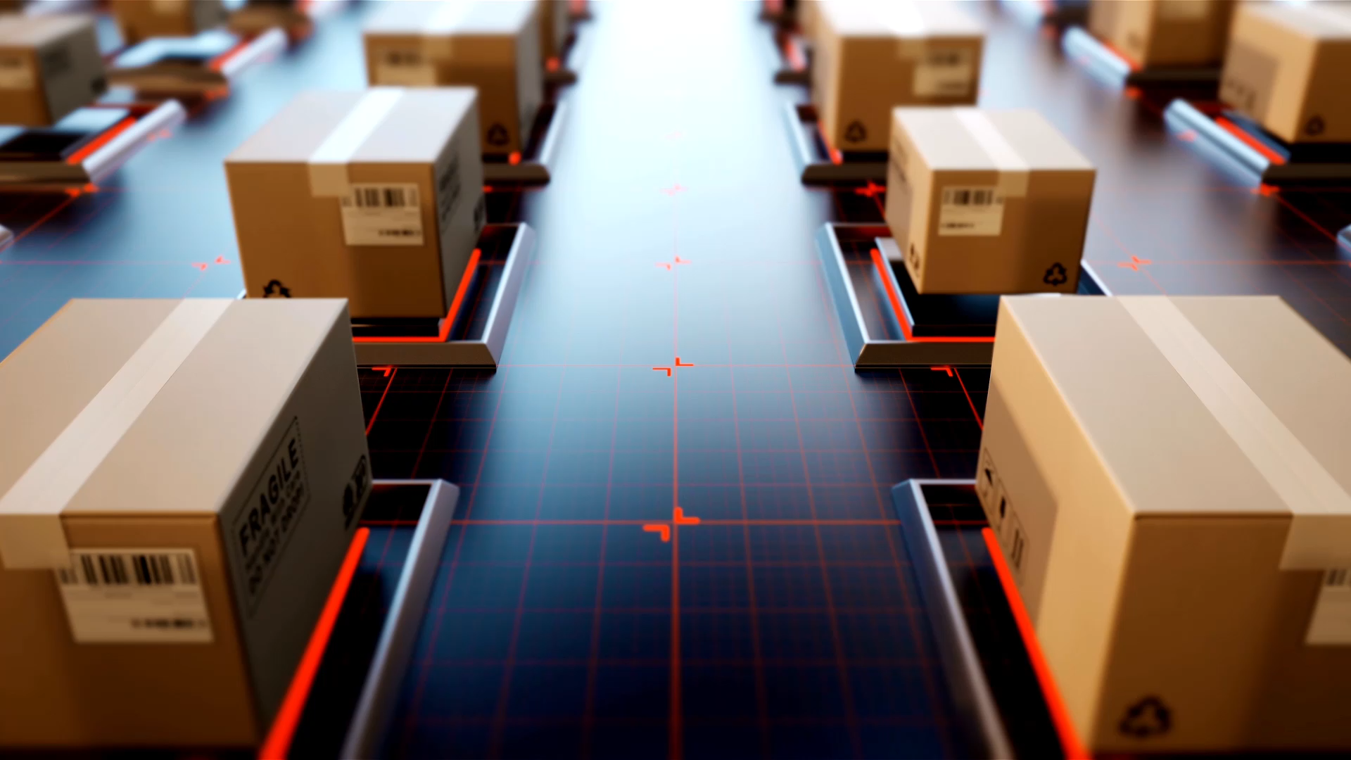
TSF3313 FILE SYSTEM FORENSICS Chapter 1 Digital Investigation Foundations

Slide 2
FILE SYSTEM FORENSICS
How can deleted files still be found?
A file system is the method an operating system uses to:
Organize,
Store, and
Manage access to data on a storage device (like a hard drive, SSD, or memory card).
It defines how files are named, stored, located, and retrieved. You can think of it as the “library catalog” of a computer’s storage.

Slide 3
File System Forensics is the study of how digital evidence is stored, organized, and deleted within a computer’s file system.
It focuses on examining file structures, metadata, and storage allocation to reconstruct user activity.
Understanding file systems allows forensic investigators to retrieve deleted data, trace actions, and verify authenticity — forming the foundation of digital evidence analysis.

Slide 4
Digital Investigations and Evidence
The focus of a digital investigation is going to be some type of digital device that has been involved in an incident or crime.
The digital device was either used to commit a physical crime or it executed a digital event that violated a policy or law.
Examples when an attacker gains unauthorized access to a computer, a user downloads contraband material, or a user sends a threatening e-mail.
When the violation is detected, an investigation is started to answer questions such as why the violation occurred and who or what caused it to occur.

Slide 5
Digital Investigations and Evidence (cont.)
A digital investigation is a process where we develop and test hypotheses that answer questions about digital events.
This is done using the scientific method where we develop a hypothesis using evidence that we find and then test the hypothesis by looking for additional evidence that shows the hypothesis is impossible.
Digital evidence is a digital object that contains reliable information that supports or refutes a hypothesis.
Exercise: Give examples of digital evidence. Give examples of digital investigations case.

Slide 6
Digital Investigations and Evidence (cont.)
A digital forensic investigation is a process that uses science and technology to analyze digital objects and that develops and tests theories, which can be entered into a court of law, to answer questions about events that occurred.

Slide 7
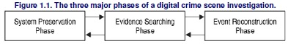
Digital Crime Scene Investigation Process
There is no single way to conduct an investigation.
A digital crime scene includes the digital environment created by software and hardware.
The process has three major phases (Carrier and Spafford, 2003), which are system preservation, evidence searching, and event as shown in figure 1.1.

Slide 8
Digital Crime Scene Investigation Process (cont.)
This process can be used when investigating both live and dead systems.
A live analysis occurs when you use the operating system, or other resources of the system being investigated to find evidence.
A dead analysis occurs when you are running trusted applications in a trusted operating system to find evidence.
With a live analysis, you risk getting false information because the software could maliciously hide or falsify data.
A dead analysis is more ideal but is not possible in all circumstances.

Slide 9
Digital Crime Scene Investigation Process (cont.)
System Preservation Phase tries to preserve the state of the digital crime scene.
The actions in this phase are vary depending on the legal, business, or operational requirements of the investigation.
For example, legal requirements may cause you to unplug the system and make a full copy of all data.
System Preservation Phase

Slide 10
Digital Crime Scene Investigation Process (cont.)
The purpose of this phase is to reduce the amount of evidence that may be overwritten.
This process continues after data has been acquired from the system because we need to preserve the data for future analysis.
In Chapter 3, "Hard Disk Data Acquisition," we will look at how to make a full copy of a hard disk, and the remainder of the book will cover how to analyze the data and search for evidence.
System Preservation Phase (cont.)

Slide 11
Digital Crime Scene Investigation Process (cont.)
Preservation Techniques
For a dead analysis
terminate all processes by turning the system off and make duplicate copies of all data.
For a live analysis
suspect processes can be killed or suspended.
network connection can be unplugged (plug the system into an empty hub or switch to prevent log messages about a dead link), or network filters can be applied so that the perpetrator cannot connect from a remote system and delete data.
When important data are saved during a dead or live analysis, a cryptographic hash should be calculated to later show that the data have not changed.
A cryptographic hash, such as MD5, SHA-1, and SHA-256, is a mathematical formula that generates a very big number based on input data. If any bit of the input data changes, the output number changes dramatically. Therefore, if the hash value of your important data changes, then you know that the data has been modified.
System Preservation Phase (cont.)

Slide 12
Digital Crime Scene Investigation Process (cont.)
Looking for data that support or refute hypotheses about the incident.
This process typically starts with a survey of common locations based on the type of incident, if one is known.
For example
investigating Web-browsing habits, will look at the Web browser cache, history file, and bookmarks.
Investigating a Linux intrusion, look for signs of a rootkit or new user accounts.
As the investigation proceeds and develop hypotheses, search for evidence that will refute or support those hypotheses.
It is important to look for evidence that refutes your hypothesis instead of only looking for evidence that supports your hypothesis.
Evidence Searching Phase

Slide 13
Digital Crime Scene Investigation Process (cont.)
Search Techniques
Most searching for evidence is done in a file system and inside files.
A common search technique is to search for files based on their names or patterns in their names.
Another common search technique is to search for files based on a keyword in their content.
We can also search for files based on their temporal data, such as the last accessed or written time.
Evidence Searching Phase (cont.)

Slide 14
Digital Crime Scene Investigation Process (cont.)
Trying to answer questions about digital events in the system.
During the Evidence Searching Phase, we might have found several files that violate a corporate policy or law, but that does not answer questions about events.
Example: One of the files may have been the effect of an event that downloaded, but we should also try to determine which application downloaded it. Is there evidence that a Web browser downloaded them, or could it be from malware?
Event Reconstruction Phase

Slide 15
Digital Crime Scene Investigation Process (cont.)
Event reconstruction requires knowledge about the applications and the OS that are installed on the system so that you can create hypotheses based on their capabilities.
For example, different events can occur in Windows, and different versions of the Crome Web browser can cause different events.
Event Reconstruction Phase (cont.)

Slide 16
Data Analysis
Is going to narrow down the different places where we can search for digital evidence

Slide 17
Data Analysis (cont.)
When analyzing digital data, we are looking at an object that has been designed by people.
Further, the storage systems of most digital devices have been designed to be scalable and flexible, and they have a layered design.
Analysis Types

Slide 18
Data Analysis (cont.)
There are two independent analysis areas.
based on storage devices.
Examples: storage devices, specifically non-volatile devices, such as hard disks.
based on communication devices
The analysis of communication systems, such as IP networks.
Analysis Types (cont.)

Slide 19
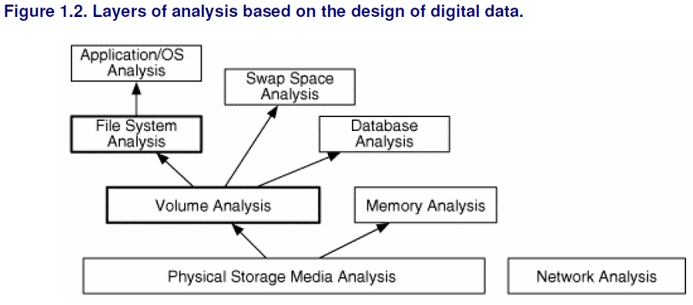
Data Analysis (cont.)
Analysis Types (cont.)

Slide 20
Data Analysis (cont.)
analyze the 1s and 0s from the physical medium.
Storage devices that are used for non-volatile storage are typically organized into volumes.
A volume is a collection of storage locations that a user or application can write to and read from.
Analysis Types (cont.)

Slide 21
Data Analysis (cont.)
Inside each volume can be any type of data, but the most common contents are file systems.
Other volumes may contain a database or be used as a temporary swap space (similar to the Windows pagefile).
To understand what is inside of a file, we need to jump to the application layer.
The structure of each file is based on the application or OS that created the file.
Analysis Types (cont.)

Slide 22
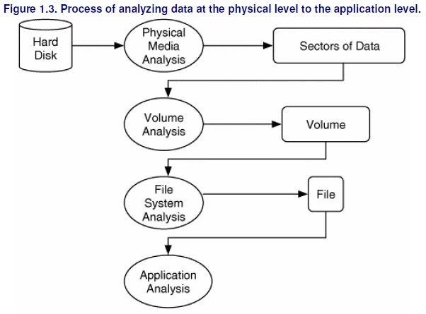
Data Analysis (cont.)
Analysis Types (cont.)

Slide 23
Discussion
Why do file systems still contain deleted data?
How does knowing the file system type affect evidence recovery?
How can timestamps mislead investigations?
Should investigators rely only on recovered files or also analyze metadata?

